Slide 1
Advocacy and Outreach Specialist – Title IX
Working Together to Prevent Sexual Assault on the College Campus: Creating an MOU with your local Rape Crisis Center
Brandi Fischer
Notes:
Prior to the presentation you can send out the Video from slide 10 and the Know Your IX website for presentation participants to view.
Personal introduction including why you are passionate about educating on/preventing sexual violence.

Slide 2
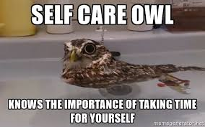
Self Care

Slide 3
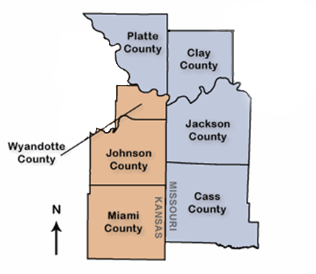
MOCSA Service Area
MOCSA serves the entire
metropolitan area.
Kansas: Johnson, & Wyandotte Counties
Missouri: Clay, Cass, Platte & Jackson Counties

Slide 4
MOCSA Services
24-hour crisis line
Advocacy Services
Counseling Services
Education

Slide 5
What’s happening on campus?
19% of undergraduate women reported experiencing completed or attempted sexual assault since entering college
Most of the assaults were committed by someone the victim knew and the perpetrators are often serial rapists
94% off college men DON’T rape. The 6% who do rape will commit an average of 6 rapes each by the time they graduate
Many college rapists target people who are drugged, drunk, passed out, or otherwise incapacitated
Only 2% of incapacitated rape victims reported the assault to law enforcement
(U.S Department of Justice, Office of Violence Against Women, 2016)

Slide 6
Title IX Timeline
1972
1980
1992
1999
2003
2011
2014
2015
Title IX was passed
Alexander
v.
Yale
Franklin
v.
Gwinnett County Schools
Davis
v.
Monroe County Board of Education
Kelly
v.
Yale University
Office for Civil Rights released the Dear Colleague letter on Title IX
Office for Civil Rights released the Q and A guide on Title IX and Sexual Violence
Office for Civil Rights released the Title IX Resource Guide
Prohibits gender-based discrimination within educational institutions.
Colleges are required to respond to student rape allegations and provide reasonable accommodations
Sexual harassment is considered discrimination
Schools are liable for student on student harassment
Sexual assault is a form of discrimination

Slide 7
Why create an MOU?
Rape crisis centers have the best resources when it comes to understanding the issues related to sexual violence
Colleges have a wealth of knowledge regarding the rules and regulations of Title IX
Rape crisis centers are often non-profit organizations that can offer their services free of charge; including trainings and counseling
Working together is in the best interest of the victim.
The Government recommends it. (NotAlone.gov)

Slide 8
Role of an Advocate
Increase comfort level for the victim
Increase the likelihood that a victim will follow through with the Title IX investigation process
Allows Title IX Coordinator to focus on the investigation
Offer community resources to the victim
Can continue working with the victim after the Title IX Investigation is over
(Campbell, 2006)

Slide 9
Creating the MOU – Description of Agency/History of Previous Collaboration
Include services that the rape crisis center provides and how many people the services are provided to
When was the college founded, how many students are enrolled, and mission statement
Include a brief description of previous collaboration between the two agencies; professional trainings, student trainings, etc.

Slide 10
Creating the MOU – Rape Crisis Centers
The rape crisis center should appoint an advocate to work with the school, which would also be the point of contact for the school
Support victims from the schools; hospital advocacy, law enforcement advocacy, and personal advocacy
Provide constant communication with the Title IX Coordinator regarding trends in services and additional services that may be needed
Deliver training to students and faculty/staff on the issues surrounding sexual violence
Act as a member of the SART or CCR team. Provide assistance when developing prevention programming and training
Provide Title IX Coordinator information on website
Time on campus for advocate
(Center for Changing Our Campus Culture, changingourcampus.org, 2016)

Slide 11
Creating the MOU - Schools
Create a point of contact for the rape crisis center to simplify the referral process
Provide training to the rape crisis center staff on resources the school offers to victims, the school’s Title IX policies, and accommodations the school offers to victims
Making sure the Title IX Coordinator, or another assigned person, can meet regularly with the point of contact at the rape crisis center
Collaborate with the rape crisis center on prevention programs and events
Allow the use of school space for the rape crisis center to hold meetings, etc. (support group)
(Center for Changing our Campus Culture, changing our campus.org, 2016)

Slide 12
Creating the MOU - Confidentiality
Most people employed on campus are mandated reporters.
An important role of the rape crisis center advocate is that they are not mandated reporters
It is important for the college to understand that the rape crisis center can provide confidential services to students and staff, while also providing options for the Title IX reporting process
If the victim wants information shared between the school and rape crisis center, a written release of information will allow that communication between the two agencies

Slide 13
Sexual Assault Response Team (SART) or Coordinated Community Response (CCR) Team
Creating a SART or CCR is a great way to collaborate and keep ideas flowing between the rape crisis center and members of campus
Meet once a month
Who should be on these teams?
Title IX Office
Counselors
Campus police
Rape crisis center
Students (athletes, clubs, groups)
Student center/activities
Women’s center

Slide 14
Questions???
Brandi Fischer
bfischer@mocsa.org
816.285.1345

