Slide 1
Collegiate Typologies and Behaviour Identification

Slide 2
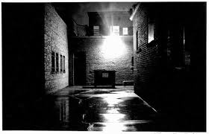
Who are the offenders?

Slide 3
Core Distinctions
Rapist and Child Molester
Male and Female Offender
Adults and Juveniles
Physical and Cyber Assaults

Slide 4
Precision of Language
Sex Offender: Broadest Category
Child Molester: Significantly older individual (3-5 yrs) engages in sexual activity with children
Rapist: Sexual perpetration against adults
Pedophile: Diagnostic, not legal term-sexual urges or behaviours toward children <13 - Exclusive-Non Exclusive
Hebephilia: Diagnostic/Not a DSM recognized term, urges or behaviours toward pubescent children <15

Slide 5
Four Dominate Rapist Typologies
*Power Reassurance
*Power Assertive
Anger Retaliation
Anger Excitation

Slide 6
Prevalence
Research indicates that 6% of men in college commit rape
91-95% of these offenders are serial rapist averaging 6 adult victims
*Roughly 260,000 male athletes in the NCAA: 15,600 offenders

Slide 7
College Setting Unique setting/Perfect storm Every Risk Factor Few Protective Factors

Slide 8
8 Convergent Risk Factors
Age of Victim
Victim Access
Social Culture
Drug Prevalence
Coercion-supporting peer groups
Age of Offender
Ubiquitous Victim Pool
Perceived Sense of Immunity

Slide 9
Preconditions for Sexual Abuse
Motivation to sexually abuse
Overcoming internal inhibitions
Overcoming external inhibitions
Overcoming victim’s resistance

Slide 10
Risk Areas for College Populations
Criminal/Delinquent Behavior
Alcohol/Drug Use
Big Five Personality Factors
Sexual Narcissism
Empathy
Attachment

Slide 11
Risk Indicators
Engagement in sexually coercive behaviours is likely to increase as the number of these factors increase.

Slide 12
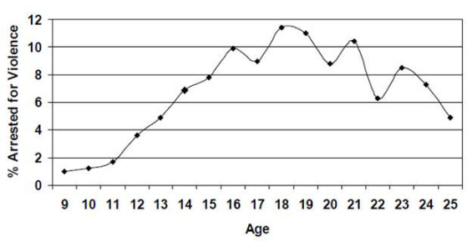
Criminal/Delinquent Behaviour

Slide 13
Criminal/Delinquent Behaviour
Juvenile offender Adult offending

Slide 14
Red Flag Indicators
History of criminal/delinquent behavior (Are you checking IX complaints from HS? Specifically asking HS coaches about behavior?)
Onset predicts persistence/specific types of behaviors
Reduction Indicators
Stable Relationship & Employment correlate with reduction in criminal/delinquent behavior

Slide 15
Alcohol and Drug Use
Common factor in sexual violence 75-85%
Disinhibits and reduces perception of responsibility
Widely available
Roughly ½ of all sexual assaults are committed by men who have been drinking alcohol

Slide 16
Red Flag Indicators
History of alcohol/drug abuse
Residence: Residence Halls or density of young adults living in close quarter
Affiliation with Greek Life: illicit substances, binge drinking, denial of responsibility, masculine expectations to encourage sex at parties
Male planned and executed parties: getting women drunk, blocking exits, controlling transportation, encouraging women to dress “scantily”

Slide 17
Big 5 Personality Traits Red Flag Indicators
Rude & Irritable
Unemotional (callous)
Superficially sociable
Unreliable
Careless
Sexual Narcissism

Slide 18
Sexual Narcissism
Sexual preoccupation and compulsivity
Promiscuity
Inflated sense of sexual skill
Interpersonal exploitative-ness
Sense of entitlement
Increased sexual sensation seeking

Slide 19
Red Flag Indicators
History of promiscuous or rotating cast of partners
Online Behaviors: Dating/Hook Up; Pornography Use (Gonzo); Preoccupation w/ sexual themes

Slide 20
Common Red Flag Indicators

Slide 21
Hostile Masculinity/Rape Myth Belief
Distrust of women; easily angered by women, “no means yes”; justifies sexual force
Short term “mating” strategy w/low nurturance
Highest levels of sexual assault found in men with high levels of impersonal sex and high hostile masculinity attitudes

Slide 22
Red Flag Indicators
Opinions of women suggestion unequal status
Talks down to others (men and women)
Promotes sexually dominate male perspective (promiscuous/brags about prowess)

Slide 23
Resisting Peer Influence
Heavily influenced and directed by peer coercion
Increased risk-taking behaviors through peer coercion
Increased risk of rape when peer group has “rape supportive” beliefs
Following others to fit in

Slide 24
Red Flag Indicators
Leader or follower?
Affiliation with risky group: Party Culture, Greek Life, Negative Peer Culture
Bystander Effect: does not offer assistance to victims when others are present due to diffusion of responsibility

Slide 25
Attraction of Sexual Aggression
Belief that aggressing sexually is likely to be sexually arousing
Belief he would aggress if not for fear of punishment

Slide 26
Red Flag Indicators
Expressed belief of male dominance
Use of disinhibitions: alcohol/drugs
Elevated use of pornography
Sexualized “locker room” talk

Slide 27
Putting it all together: Power Assertive Rapist Typology

Slide 28
Power Assertive Rapist or “Entitled Rapist”
Higher number of college based offenders
Motivation is to prove virility and power
Typically short pre-exposure to the victim

Slide 29
May have criminal history of aggression Used abusive language/obscenities towards victim Moderate force/no pre-planning Assaults are typically NOT in personal residence Multiple victims/episodic Hyper-masculine persona (internal/external)
Delayed orgasm/lower DNA rates at the scene
Self-centered/control issues
Utilizes bars/parties for access
History of conflict with women
Higher rates of physical abuse as child
Has consenting sex partner
Athletic, has “masculine” job

Slide 30
Alternative Offender: Power Reassurance Rapist Typology

Slide 31
Power Reassurance Rapist or “Gentleman Rapist”
Insecure, low self-esteem, feel inadequate
Motivation is to restore his self-confidence
Claims consent or convinces himself of consent
Purpose is to possess, no harm
May attempt to sexually satisfy victim

Slide 32
Premeditated/Multiple targets Fantasy that victim wants him/interactive Provides contact information Asks personal questions Minimal criminal record Takes pride in personal appearance Commits offenses close to home or work
Souvenirs
Serial offenders “He said, They said”
May apologize or attempt second assault
Less social/fewer friends
Socially awkward
Does not cause unnecessary harm
Increased rates of strangulation

Slide 33
The Undetected Rapist

Slide 34
Response & Counters Systemic and Individual

Slide 35
Individual Response: Empathy
Empathy is… the ability to understand and share the feelings of others
Important: Significant factor in mitigation of the expression of aggression
Facilitation: Ask the student to place themselves in the victim/survivors experience. “What do you think the impact has been for her?” “How do you image she felt when you stood in front of the door?”
*Deflect self pity. This leads to justification. “Yes, this is difficult and scary; however, you are responsible for this situation and your actions.”

Slide 36
Individual Response: Personalization
Personalize the victim/survivor: always refer to the victim/survivor by name not just “that girl” etc.
Focus on what the student did, not on what the victim/survivor did. You are not talking about her. Someone else is talking with her and about her. Your role is to talk about and connect with the student who caused harm. “I understand you are angry at “Sara,” but we are not going to talk about her action we are going to talk about yours, because that is what you are in control of.”
Facilitation: Ask the student what her name is. Make comments about the victim/survivor as a person. Always have the student refer to the victim/survivor by name not a derogatory term.

Slide 37
Individual Response: No “Othering”
Avoid labeling the student as “bad” or “rapist” when you are working with them. Shamming them and tearing them down increases isolation and decreases attachment. These are both risk factions in recidivism.
This creates “othering” between you and the student. You will not be able to connect with the student in a way that is genuine.
Facilitation: Separate them from the action when you are working with them. “Your behavior was offensive or harmful, but you are a only your behavior. You can and are more than what you did.”

Slide 38
Individual Response: Environmental Acknowledgement
Acknowledge that the messages men may receive about negative masculinity.
Challenge the student to reassess his beliefs about male roles and what it means to be a man regarding healthy and unhealthy sexual beliefs.
Facilitation: “We are all affected by the systems we were raised and this is partially reflected in how we act.” “I understand that cultural and media have told you this behavior is acceptable, but that doesn’t make it right.”

Slide 39
Individual Response: Encouragement
Encourage the student to consider the multiple factors that lead to their behavior. A flip was not switched, it was a pattern of events.
Refer back to the four pre conditions of abuse: Motivation, Internal Inhibitors, External Barriers, Victim Resistance.
Those were all overcome and each shows a decision and choice by the student.
Facilitation: “Saying I was drunk is over simplification. May other people were drunk that very same night, you are the one here because of the many choice you made throughout the night.“

Slide 40
Attachment Describes…
The dynamics of long term and short term interpersonal relationships
Important: Sexual aggressors typically are more insecurely attached (fearful of closeness, controlling in relationships)

Slide 41
Education
Multi session education
High Dose education in a natural environment
Consistent and pervasive behavior role modeling people of personal value
Indicated education for offenders

Slide 42
Environmental
Reduction in high risk times, places, events, activities
Monitoring of overlapping social affiliations
Reduction in sexual violence facilitation and apathy

Slide 43
Pro Social Bystander Intervention
Challenging causal conversations and statement
Cultivating a culture of respect and accountability (formal and informal)
Increase willingness to intervene (large and small)

Slide 44
Internal Restorative Justice Model
Connecting with personal stake holders (people who matter most)
Working to repair harm internally with peers and community
Respected mentor to hold accountable or curb recidivism
Identify and empower peer thought leaders to verbalize cultural expectations
Establishment of personal attachments

Slide 45
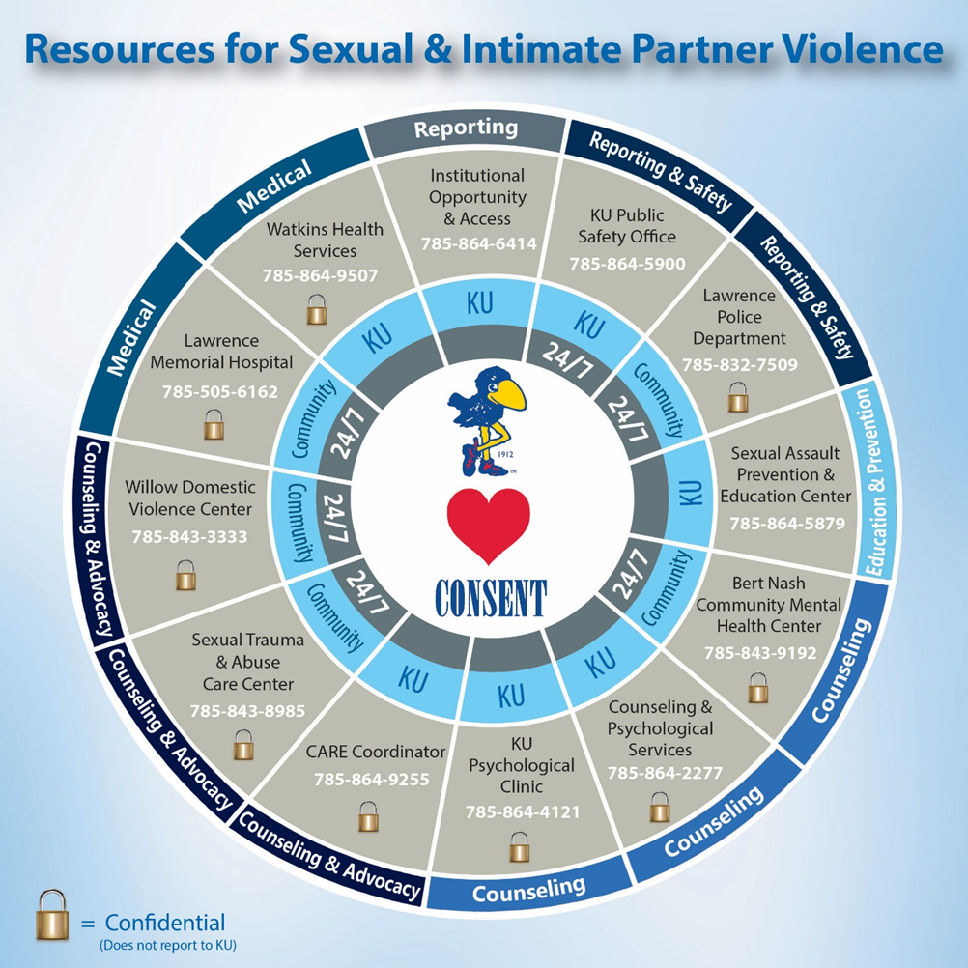
Resources Stopitnow.org

Slide 46
Contact Info
785-864-5879
sapec@ku.edu
116 Carruth O’leary
Twitter @ku_sapec
Snapchat
ku_sapec
Facebook
kusapec
sapec.ku.edu

